Slide 1

Python Programming Language
20221001

Slide 2
OBJECTIVE
• LEARNING PYTHON
• INPUT AND OUTPUT
• DATA TYPES
• OPERATOR

Slide 3
CONTENT
o What is Python?
o Python Jobs
o Why to Learn Python?
o Python Online Interpreter
• One
• Two
o Google Colab
o Python Code

Slide 4
What is Python
Python is a popular programming language. It was created by Guido van Rossum, and released in 1991.
It is used for:
Web development (server-side)
Software development,
Mathematics
System scripting.

Slide 5
What can Python do?
Python can be used on server to create web applications.
Python can be used alongside software to create workflows.
Python can connect to database system. It can also read and modify files.
Python can be used to handle big data and perform complex mathematics.
Python can be used for rapid prototyping, or for production-ready software development.

Slide 6




Why Python
Python works on different platforms ( Windows, Mac, Linux, Raspberry Pi, etc).
Python has a simple syntax similar to the English language.
Python has syntax that allows developers to write programs with fewer lines than some other progamming languages.
Python runs on an interpreter system, meaning that code can be executed as soon as it is written. This means that prototyping can be very quick.
Python can be treated in procedural way, an object-oriented way or a functional way.

Slide 7






Python Jobs
• Career Opportunities Python language provides several job opportunities and promises high growth with huge salary prospects. Some of the big and renowned companies that use Python for their development are:

Slide 8
Why to learn python?
Python is a very popular programming language today and often needs an introduction. It is widely used in various business sectors, such as programming, web development, machine learning, and data science. Given its widespread use, it’s not surprising that Python has surpassed Java as the top programming language.
The Top 10 Reasons
1.Career Opportunities and Salary 6. Libraries and Packages
2. Data Science 7. Testing Frameworks
3. Machine Learning 8. Portable and Extensible
4. Web Development 9. Active Community
5. Scripting and Automation 10. Easy to Use

Slide 9
Why to learn python?
• Often, programmers fall in love with Python because of the increased productivity it provides. Since there is no compilation step, the edit-test-debug cycle is incredibly fast. Debugging Python programs is easy: a bug or bad input will never cause a segmentation fault. Instead, when the interpreter discovers an error, it raises an exception. When the program doesn't catch the exception, the interpreter prints a stack trace. A source level debugger allows inspection of local and global variables, evaluation of arbitrary expressions, setting breakpoints, stepping through the code a line at a time, and so on. The debugger is written in Python itself, testifying to Python's introspective power. On the other hand, often the quickest way to debug a program is to add a few print statements to the source: the fast edit-test-debug cycle makes this simple approach very effective.

Slide 10
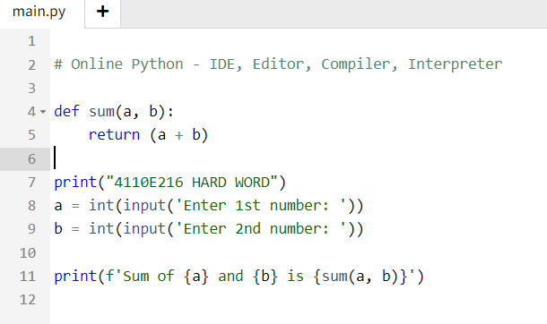
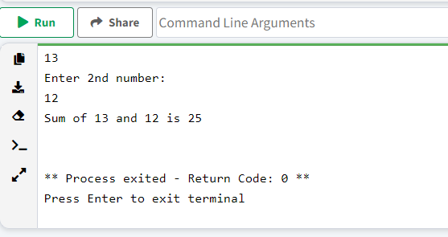
Python Online Interpreter: 1

Slide 11
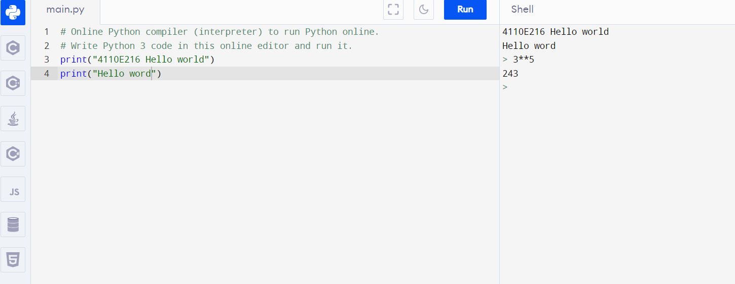
Python Online Interpreter:
Interactive

Slide 12
INPUT AND OUTPUT

Slide 13
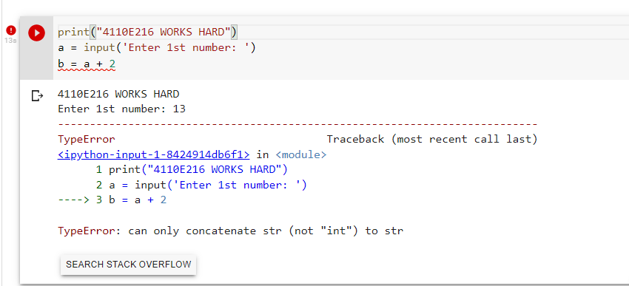
Question:
Data type

Slide 14
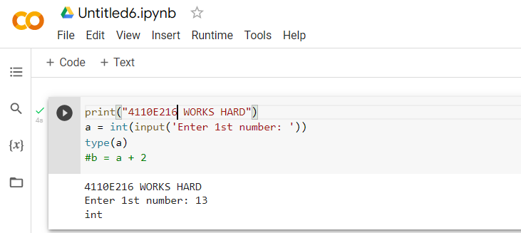
Way: 1

Slide 15
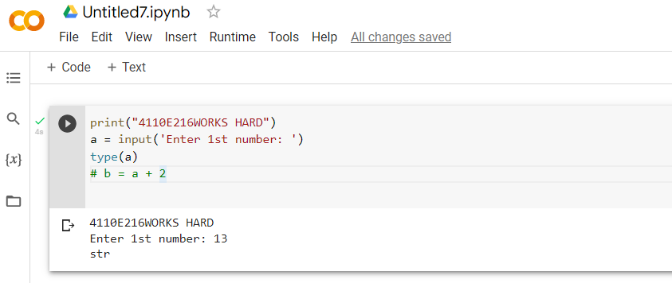
Way: 2

Slide 16
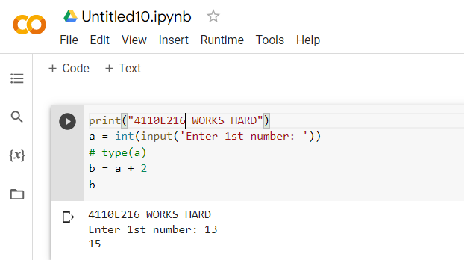
Answer:1

Slide 17
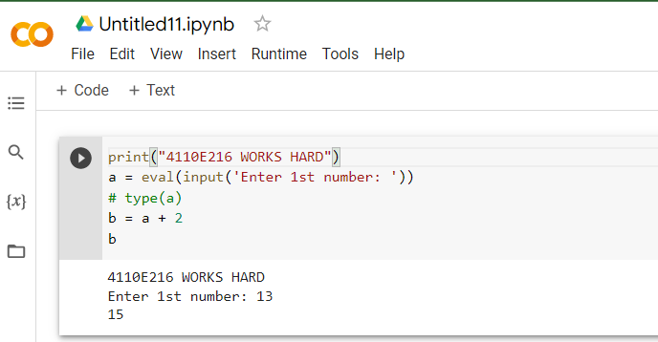
Answer:2

Slide 18
PYTHON DATA TYPES
20221001

Slide 19
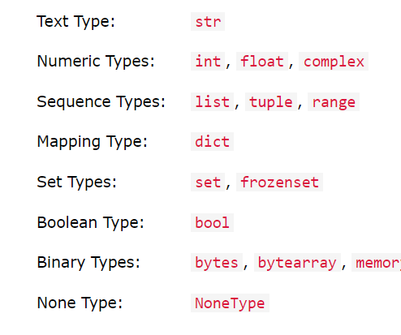
DATA TYPES:

Slide 20
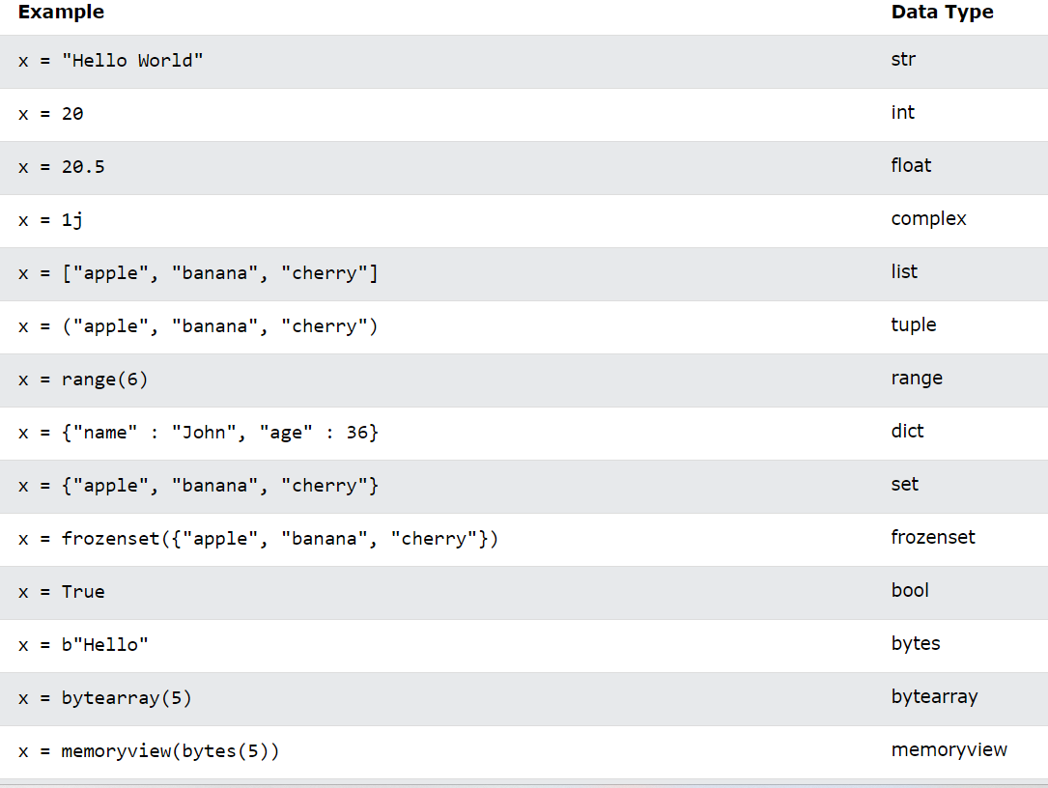
SETTING THE SPECIFIC DATA TYPES:

Slide 21
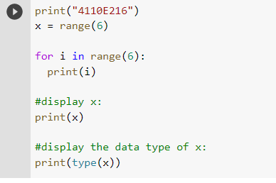
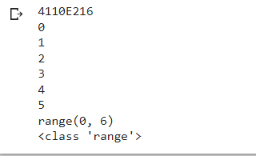
PYTHON DATA:

Slide 22
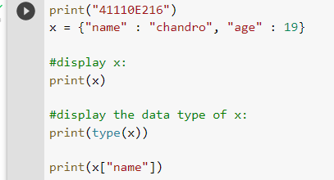

dict: key-value pair

Slide 23
PYTHON OPERATORS
20221001

Slide 24
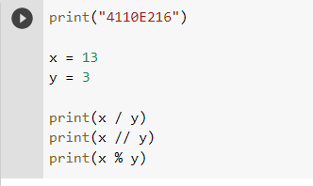
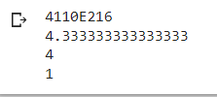
Python Arithmetic Operators

Slide 25
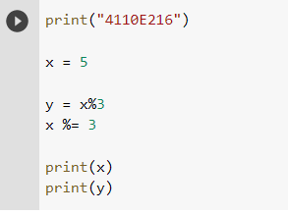

Python Assignment Operators

Slide 26
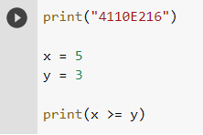

Python Comparison Operators

Slide 27
Python Comparison Operators
[“apple”,”banana”]
[“apple”,”banana”]
z=x
z
x
y
x is y == > False
X == y > True

Slide 28
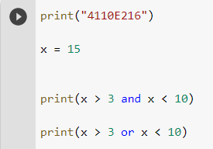

Python Logical Operators

Slide 29
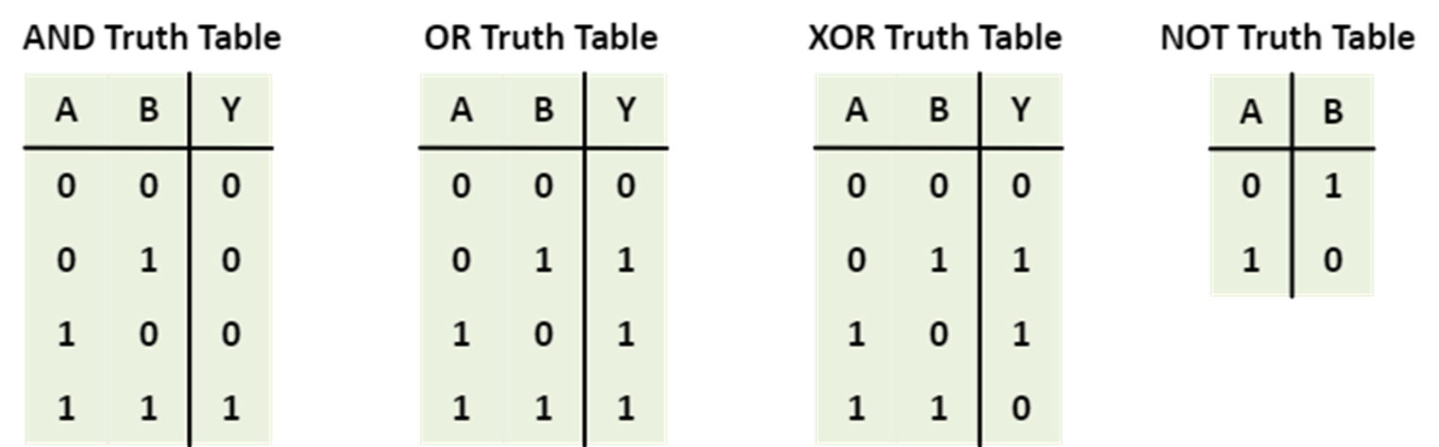
Python Logical Gate
1 == > TRUE
0 == > FALSE

Slide 30
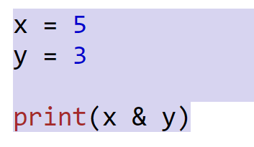
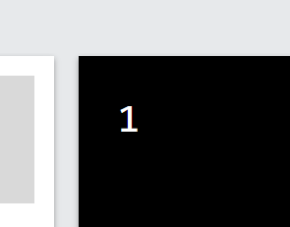
Python Bitewise Operators
binary
1*2²+0*2¹+1*2⁰
x = 5
(101)₂
y = 3
(011)₂
print(x & y)
(001)₂

Slide 31
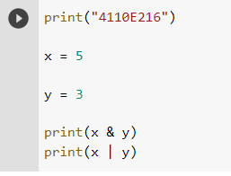

Python BitewiseOperators

Slide 32
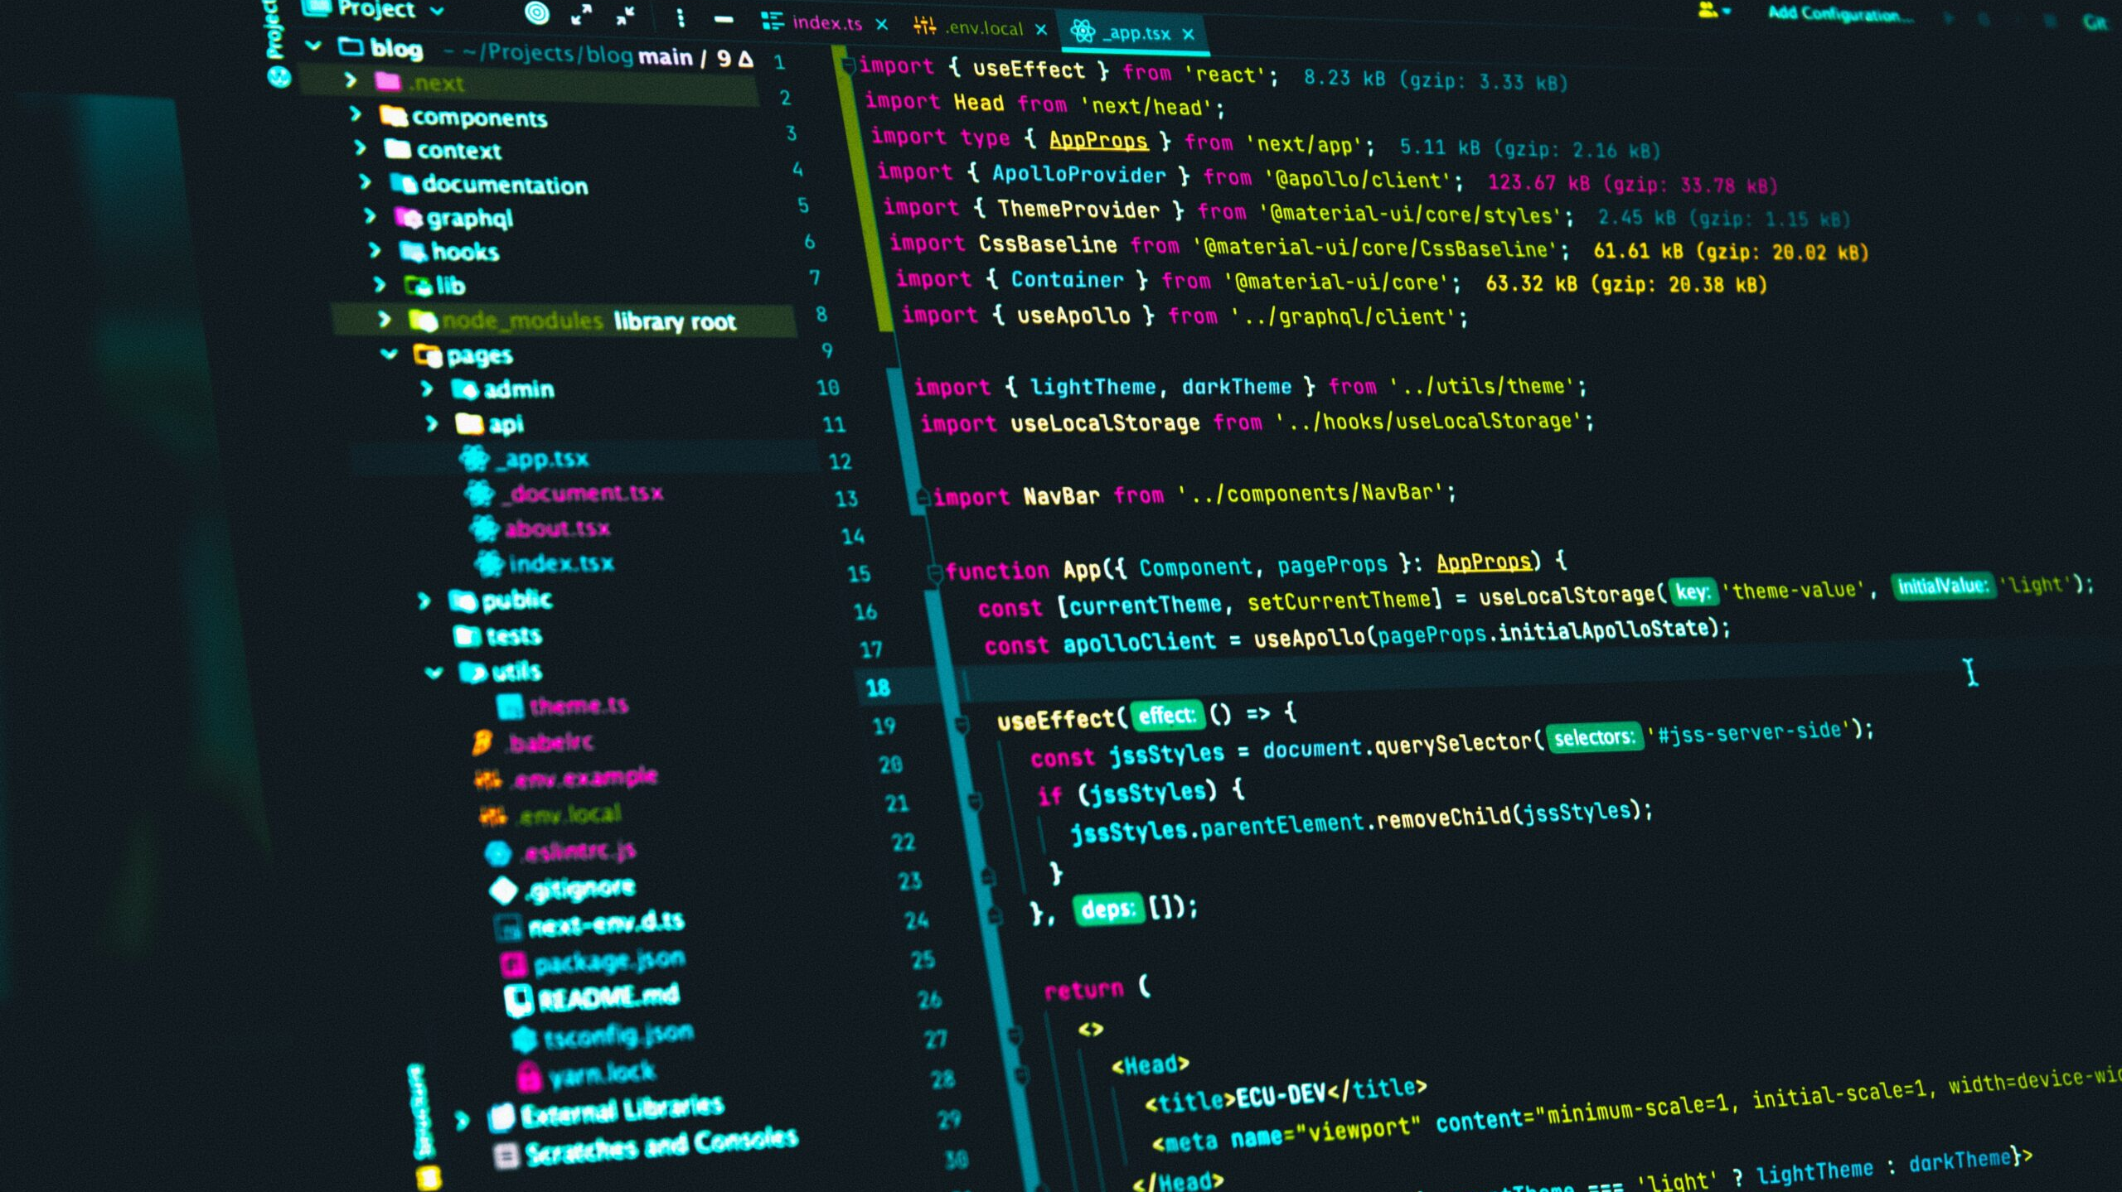
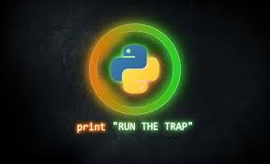
THANK YOU!
CHINES NAME: 錢德
STUDENT ID: 4110E216
ENGLISH NAME: Chandro S. Ermitanio
NICKNAME: Chan/Chand
Email: chandroermitanio95@gmail.com
GITHUB: https://github.com/4110e216/cs2022.git

